Slide 1
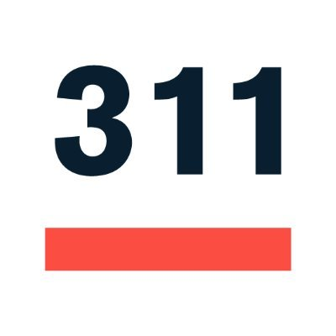
Analyzing Requests
Team 1

Slide 2

Analyzing 311 Requests Team
Sponsor: Boston City Councilor Julia Mejia
Team 1: Ivan Nikitovic
Haoxuan Sun
Stephen Wong
Katherine Yoon
Motivation: We want to find if there is a pattern between areas that report 311 calls and have them responded to, and the demographics of those regions.
Goal: Analyze patterns in 311 requests, geography, and various demographics in order to see who feels empowered to make the requests and if they have been responded to equitably.
Background: Using 311 and Social Vulnerability Index datasets, we want to study the relationships between vulnerable populations and their requests.
Notes:
Motivation: We want to find if there is a pattern between areas that report 311 calls and have them responded to, and the demographics of those regions.
Goal: Analyze patterns in 311 requests, geography, and various demographics in order to see who feels empowered to make the requests and if they have been responded to equitably.
Background: Using 311 and Social Vulnerability Index datasets, we want to study the relationships between vulnerable populations and their requests.

Slide 3
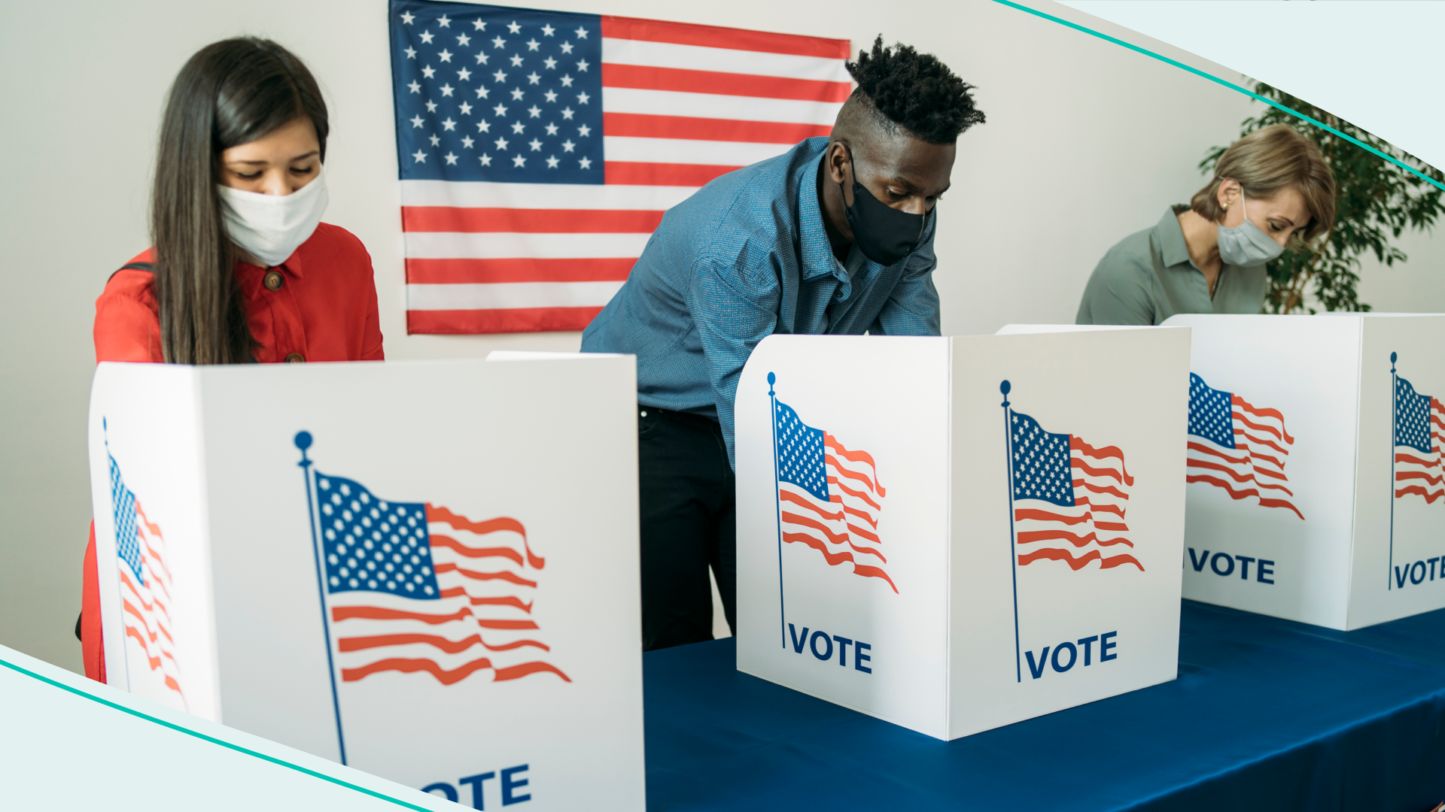
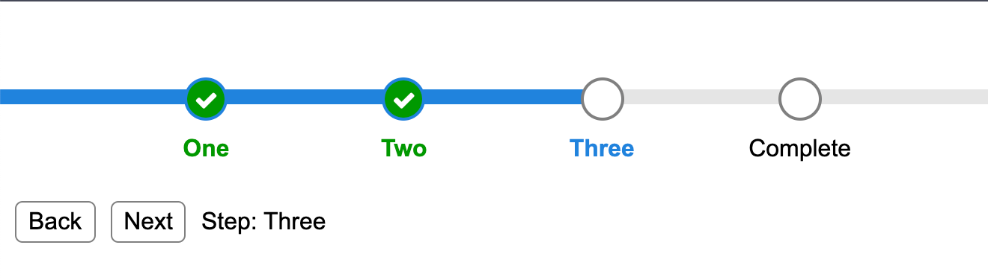
What We’ve Done so Far
Data Used:
Social Vulnerability Index = Climate Ready Boston Social Vulnerability dataset
Voter File for Boston = The dataset containing voter information
Boston 311 dataverse = The dataset with 311 calls from the past years.
Progress:
Cleaned and joined the data sets
Found correlations between Social Vulnerability Index and likelihood of making 311 calls.
Detect similarities between voting status (i.e. registered voters and and civic empowerment? What is the average voting turnout for each district over past XX years?

Slide 4
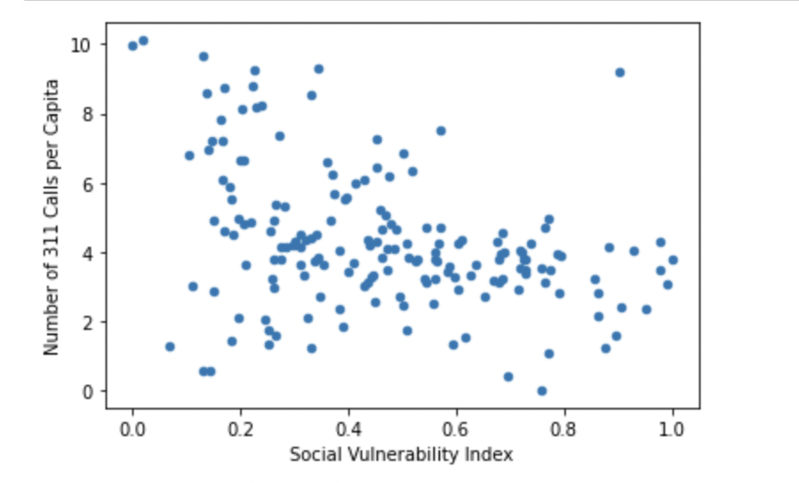
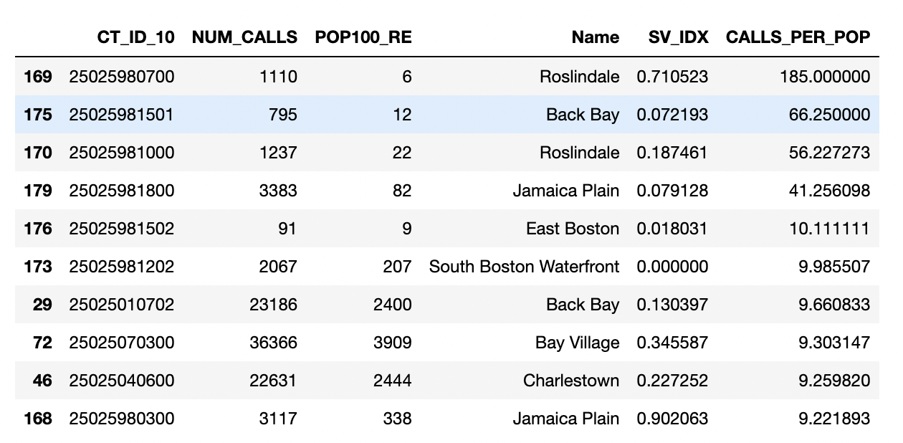
Analyze which [geography] submitted the most service requests?

Slide 5
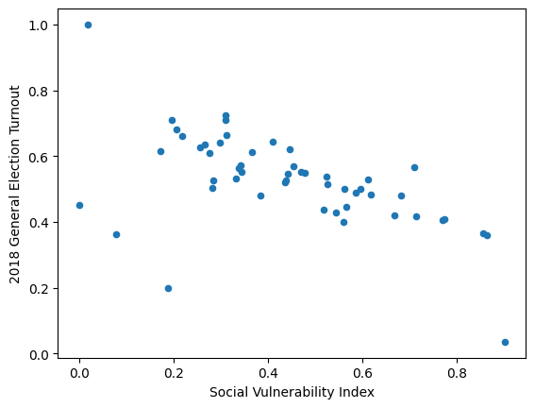
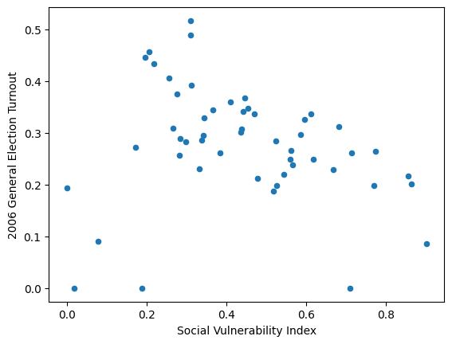
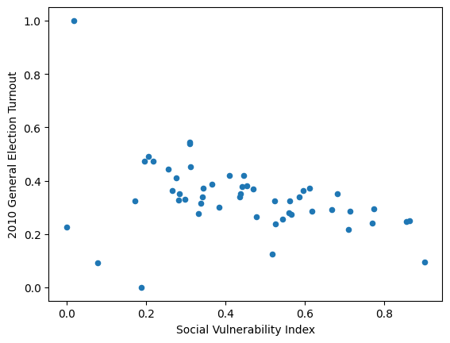
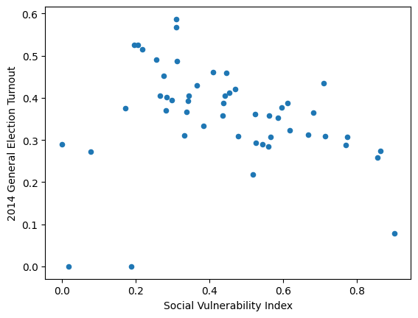
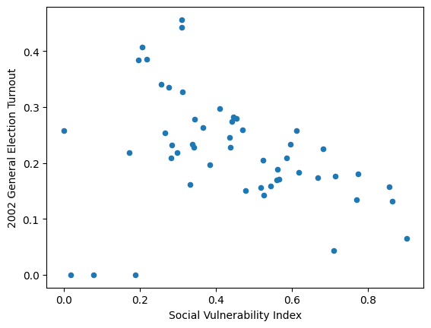
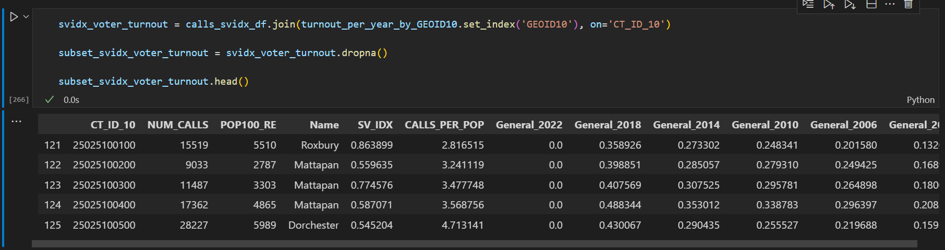
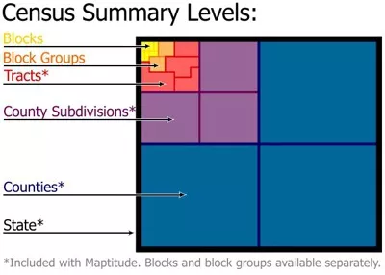
What is the relationship between voting status (i.e. registered voters and and civic empowerment? What is the average voting turnout for each district over past XX years?

Slide 6

Challenges
Data not being entirely compatible (GEOID), missing data, etc.
Confusion of tasks

Slide 7
Extension Proposal
Pitch: Analyze the relationship between building/property violations and 311 requests using data.boston.gov dataset
Rationale: Because 311 is for non-emergency requests, we expect there to be a relationship with it and property violations. With this new data, we could find areas where building violations are more frequent, therefore being able to set more specific resources towards those areas. This would be more specialized resources rather than easier requests such as graffiti and trash removal.
Questions for Analysis:
Is there a pattern between neighborhoods with more property violations and 311 requests made?
What areas have the most property violations?

Slide 8
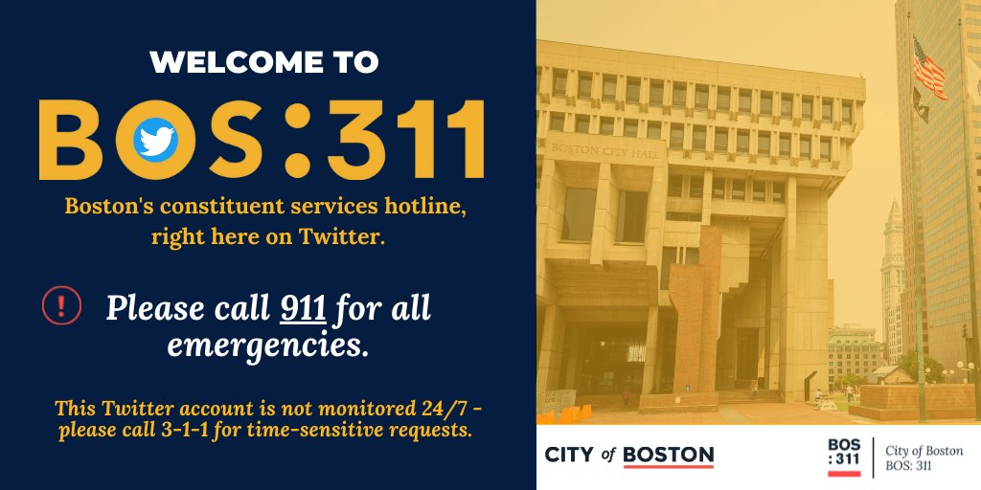
Thank you!

